Slide 1
Zephyr: A State-Based, Event-Driven, Domain-Specific Language for 2D, Top-Down, Action Role-Playing Games
Tyler Wolverton
Thesis Defense

Slide 2
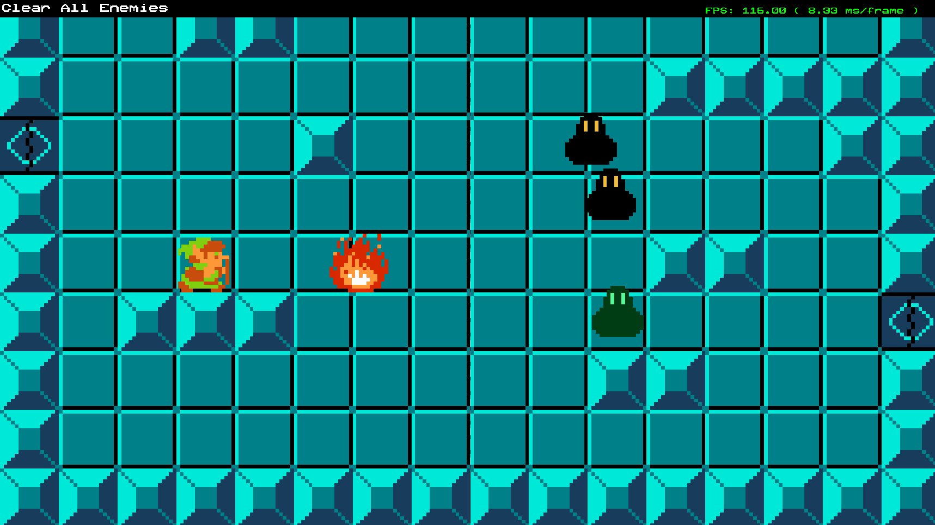
Introduction
Introduction
Scope
Schedule
Theory
Previous Work
Artifact
Implementation
Architecture
Syntax
User Feedback
Profiling Results
Bibliography
Zephyr is a domain-specific language that defines state machines that can listen to and fire events to interact with a custom C++ game engine.
Source scripts are compiled into bytecode at game startup and interpreted by a virtual machine (VM) at runtime.
The language is demonstrated with a 2D action role-playing game (RPG) similar to The Legend of Zelda (NES).

Slide 3
Scope
Introduction
Scope
Schedule
Theory
Previous Work
Artifact
Implementation
Architecture
Syntax
User Feedback
Profiling Results
Bibliography
Compiler and Bytecode VM
Designer friendly syntax
Hot reloading
2D, top-down, action RPG game demo

Slide 4
Out of Scope
Introduction
Scope
Schedule
Theory
Previous Work
Artifact
Implementation
Architecture
Syntax
User Feedback
Profiling Results
Bibliography
Interactive Debugging
An active area of research in computer science that could be a separate thesis.
Visual Scripting
Node-based UI system could be a separate thesis.
Map Editor
XML files are used to define maps instead of a graphical tool.

Slide 5
Schedule
Introduction
Scope
Schedule
Theory
Previous Work
Artifact
Implementation
Architecture
Syntax
User Feedback
Profiling Results
Bibliography
Milestone | End Date | Task Hours
1 | 09/09/20 | 20
2 | 09/23/20 | 18
3 | 10/07/20 | 18
4 | 10/21/20 | 20
5 | 11/04/20 | 18
6 | 11/18/20 | 8
7 | 12/01/20 | 6
Winter Break | 01/28/21 | 30
8 | 02/25/21 | 13
9 | 03/04/21 | 14
10 | 03/18/21
11 | 04/01/21
12 | 04/15/21
13 | 04/29/21
14 | 05/04/21
Total |  | 165
Two-week milestones
Including all research and documentation: 220 hours

Slide 6
Theory
Introduction
Scope
Schedule
Theory
Previous Work
Artifact
Implementation
Architecture
Syntax
User Feedback
Profiling Results
Bibliography
Genre
Event System
Syntax/DSLs
Compiler
Scanner
Parser
Virtual Machine
Bytecode
Finite State Machine AI
Visual Studio Code Plugin

Slide 7
Genre
Introduction
Scope
Schedule
Theory
Previous Work
Artifact
Implementation
Architecture
Syntax
User Feedback
Profiling Results
Bibliography
Action RPG systems can be defined in data easily [1].
Common functionality includes enemies, dialogue with NPCs, and interactable environment objects.
The Legend of Zelda and Dungeon Explorer were used to identify common functionality within the genre [2][3].

Slide 8
Event System
Introduction
Scope
Schedule
Theory
Previous Work
Artifact
Implementation
Architecture
Syntax
User Feedback
Profiling Results
Bibliography
Events are an effective way to communicate between states in a scripting system [4].
Events can be used to communicate between the game engine and script objects [5].

Slide 9

Syntax/DSLs
Introduction
Scope
Schedule
Theory
Previous Work
Artifact
Implementation
Architecture
Syntax
User Feedback
Profiling Results
Bibliography
Benefits of a DSL [6][7]
More effectively communicate with domain experts
Focus on high level concepts by hiding implementation details
Errors are specific to domain
Easier for non-programmers to use
Highly tuned for a specific purpose
Zephyr has built in Entity, Vec2, state machines and event handling.
superEgg .1,.05,4 at .2,.2 green distort 0.01 petals 8 blue superegg .1,.1,2 at .5,.2 grey distort .02 inner .5 orange distort .02 petals 12 blue size 3 circle at .35,.35 size .05 distort .04 petalblue petals 8 size 20 petalblue superegg .1,.05,4 at .2,.45 white distort .1 inner .5 distort .01 yellow
Figure 1: Whimsy code and output example [8].

Slide 10
Compiler
Introduction
Scope
Schedule
Theory
Previous Work
Artifact
Implementation
Architecture
Syntax
User Feedback
Profiling Results
Bibliography
Script source is compiled into bytecode.
Scanner converts source into tokens.
Parser converts tokens into bytecode.

Slide 11
Scanner
Introduction
Scope
Schedule
Theory
Previous Work
Artifact
Implementation
Architecture
Syntax
User Feedback
Profiling Results
Bibliography
The scanner uses a single token lookahead approach to process the source string into a list of tokens [9].
Token data
Type
Data
Line number

Slide 12
Parser
Introduction
Scope
Schedule
Theory
Previous Work
Artifact
Implementation
Architecture
Syntax
User Feedback
Profiling Results
Bibliography
The Zephyr compiler is a single-pass compiler, which converts tokens directly into bytecode.
Zephyr compiles one source file into multiple chunks of bytecode to be managed as states and events.
Each bytecode chunk is small and does not need much context which makes a single-pass compiler feasible [9].

Slide 13
Virtual Machine
Introduction
Scope
Schedule
Theory
Previous Work
Artifact
Implementation
Architecture
Syntax
User Feedback
Profiling Results
Bibliography
Each chunk of bytecode is interpreted by a virtual machine at runtime. The VM processes the bytecode one byte at a time and executes each operation.

Slide 14
Bytecode
Introduction
Scope
Schedule
Theory
Previous Work
Artifact
Implementation
Architecture
Syntax
User Feedback
Profiling Results
Bibliography
Bytecode contains instructions and references to constant values used in operations [10].
Constant values are saved in a side vector and the indices into that vector are saved in bytecode.
A stack is used to store intermediate values during interpretation [10].
Stack-based vs register-based
Stack instructions are smaller
Stack will have more instructions

Slide 15
Finite State Machine AI
Introduction
Scope
Schedule
Theory
Previous Work
Artifact
Implementation
Architecture
Syntax
User Feedback
Profiling Results
Bibliography
Finite state machines are a good fit for AI behavior in the context of a state-based DSL.
The main features of an AI state are the update behavior logic and transitions between states [11].
Each state can define functions to call when transitioning out of or into the state.

Slide 16
Visual Studio Code Plugin
Introduction
Scope
Schedule
Theory
Previous Work
Artifact
Implementation
Architecture
Syntax
User Feedback
Profiling Results
Bibliography
Custom language extensions can be created for Visual Studio Code by utilizing a template[12].
Static keywords, comments, and scope operators can be defined easily.
Out of Scope [13]
Highlighting variables and functions
Interactive programming environment
Interactive debugger

Slide 17
Previous Work: Uncharted 2’s Scripting Language
Introduction
Scope
Schedule
Theory
Previous Work
Artifact
Implementation
Architecture
Syntax
User Feedback
Profiling Results
Bibliography
Each script defines a finite state machine and is associated with one game object [14].
Key functionality [14]
Define attributes and states
Update function
Respond to events
State transitional actions [14]
The language uses a register-based VM and supports multi-threading using tracks [14].

Slide 18
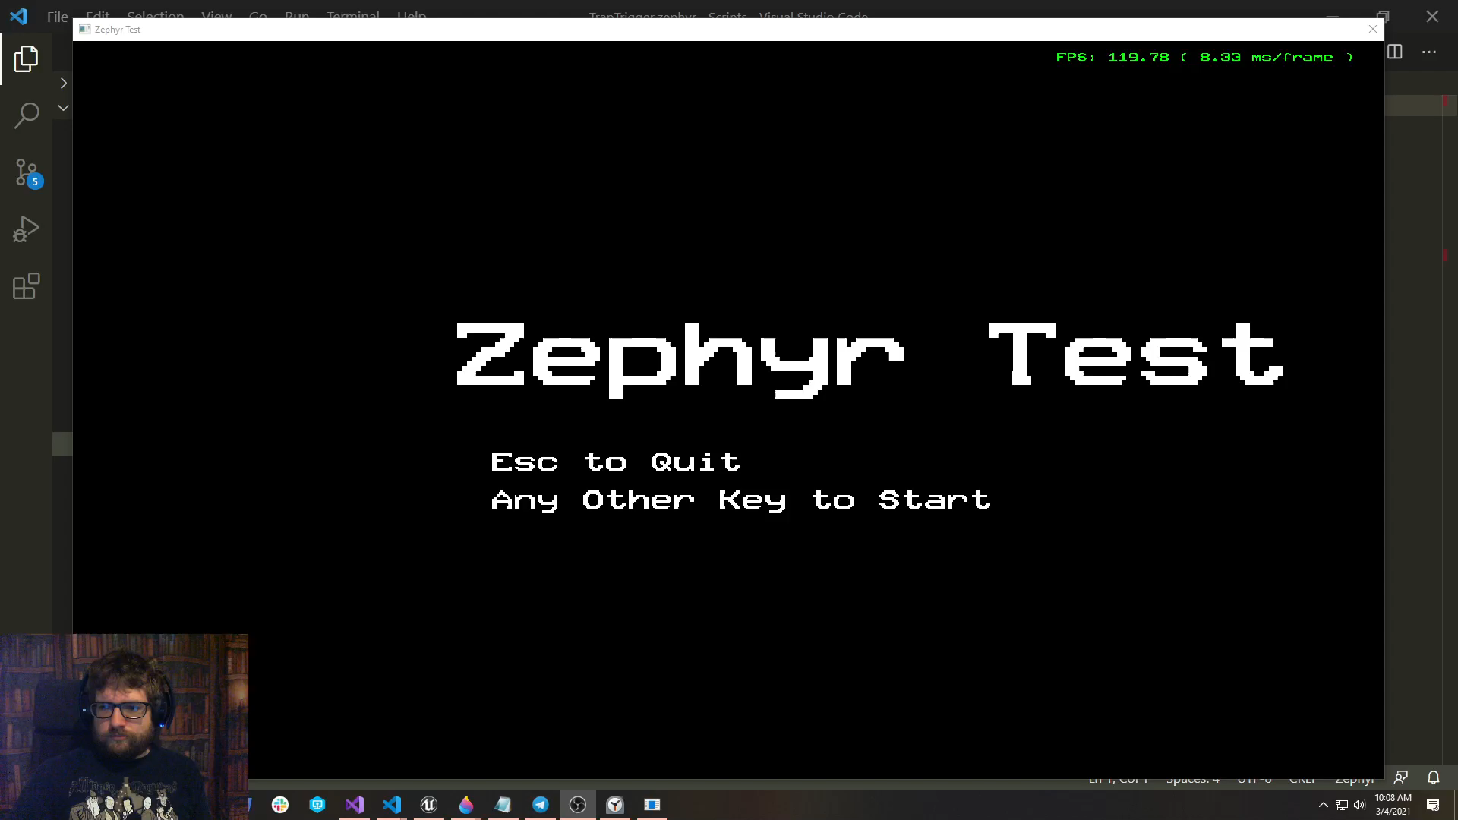
Artifact
Introduction
Scope
Schedule
Theory
Previous Work
Artifact
Implementation
Architecture
Syntax
User Feedback
Profiling Results
Bibliography

Slide 19
Implementation
Introduction
Scope
Schedule
Theory
Previous Work
Artifact
Implementation
Architecture
Syntax
User Feedback
Profiling Results
Bibliography
Compiler
Virtual Machine
Entity Architecture

Slide 20
Compiler
Introduction
Scope
Schedule
Theory
Previous Work
Artifact
Implementation
Architecture
Syntax
User Feedback
Profiling Results
Bibliography
Scanner
Parser
Bytecode generation
Error handling
Hot reloading

Slide 21
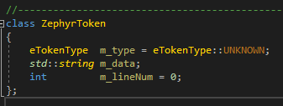
Scanner
Introduction
Scope
Schedule
Theory
Previous Work
Artifact
Implementation
Architecture
Syntax
User Feedback
Profiling Results
Bibliography
Scanner reads in source as text and converts to a vector of ZephyrTokens.

Slide 22
Parser
Introduction
Scope
Schedule
Theory
Previous Work
Artifact
Implementation
Architecture
Syntax
User Feedback
Profiling Results
Bibliography
Iterate through ZephyrToken vector and generate bytecode chunks.
Scripts have one global bytecode chunk, and each State and Function definition generates a new bytecode chunk.

Slide 23
Error Handling
Introduction
Scope
Schedule
Theory
Previous Work
Artifact
Implementation
Architecture
Syntax
User Feedback
Profiling Results
Bibliography
Parsing errors print an error message to the dev console and mark that script as invalid.
When an entity tries to update an invalid script and error is printed on the entity in the world and no bytecode is interpreted.
Invalid scripts will not run code in response to events either.

Slide 24
Hot Reloading
Introduction
Scope
Schedule
Theory
Previous Work
Artifact
Implementation
Architecture
Syntax
User Feedback
Profiling Results
Bibliography
All data files can be reloaded without closing the application.
Since data files can be inter-related, the safest way to reload is to load all maps, entities and scripts.

Slide 25
Virtual Machine
Introduction
Scope
Schedule
Theory
Previous Work
Artifact
Implementation
Architecture
Syntax
User Feedback
Profiling Results
Bibliography
Stack-based interpretation
Error handling

Slide 26
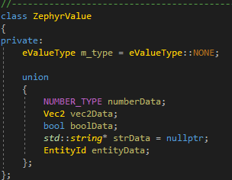
Stack-based Interpretation
Introduction
Scope
Schedule
Theory
Previous Work
Artifact
Implementation
Architecture
Syntax
User Feedback
Profiling Results
Bibliography
Temporary values are pushed into a constant stack and then retrieved by later operations.
The stack saves ZephyrValues

Slide 27
Error Handling
Introduction
Scope
Schedule
Theory
Previous Work
Artifact
Implementation
Architecture
Syntax
User Feedback
Profiling Results
Bibliography
Types are checked when performing operations. If a requested operation is not allowed an error will be thrown at runtime.
Runtime errors print to the dev console and place the entity’s ZephyrScript into an invalid state much like parser errors.
Errors are on per entity basis

Slide 28
Entity Architecture
Introduction
Scope
Schedule
Theory
Previous Work
Artifact
Implementation
Architecture
Syntax
User Feedback
Profiling Results
Bibliography
ZephyrScript
Each entity can own zero or one ZephyrScript
Handles all script events and state updates

Slide 29
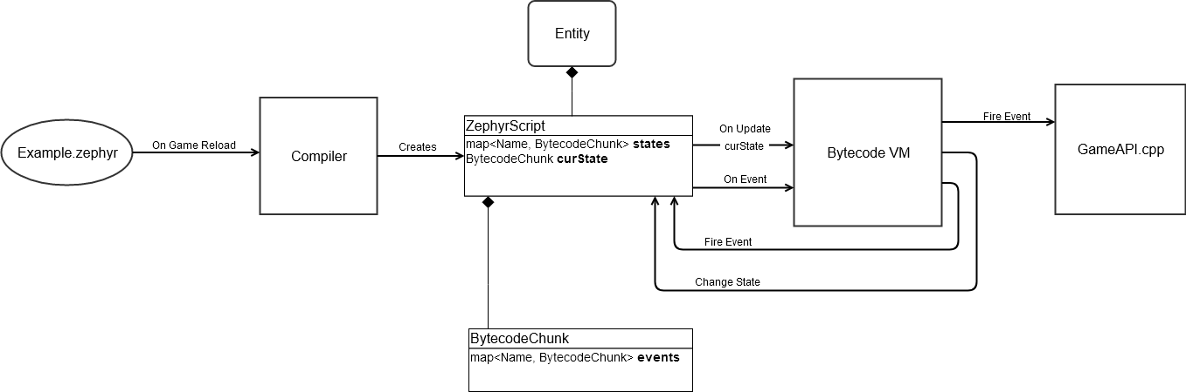
Architecture
Introduction
Scope
Schedule
Theory
Previous Work
Artifact
Implementation
Architecture
Syntax
User Feedback
Profiling Results
Bibliography

Slide 30
Architecture
Introduction
Scope
Schedule
Theory
Previous Work
Artifact
Implementation
Architecture
Syntax
User Feedback
Profiling Results
Bibliography

Slide 31
Architecture
Introduction
Scope
Schedule
Theory
Previous Work
Artifact
Implementation
Architecture
Syntax
User Feedback
Profiling Results
Bibliography

Slide 32
Architecture
Introduction
Scope
Schedule
Theory
Previous Work
Artifact
Implementation
Architecture
Syntax
User Feedback
Profiling Results
Bibliography

Slide 33
Architecture
Introduction
Scope
Schedule
Theory
Previous Work
Artifact
Implementation
Architecture
Syntax
User Feedback
Profiling Results
Bibliography

Slide 34
Syntax
Introduction
Scope
Schedule
Theory
Previous Work
Artifact
Implementation
Architecture
Syntax
User Feedback
Profiling Results
Bibliography
Overview
Functions
States

Slide 35
Overview
Introduction
Scope
Schedule
Theory
Previous Work
Artifact
Implementation
Architecture
Syntax
User Feedback
Profiling Results
Bibliography
Resembles existing scripting languages
Easier for designers and programmers to transition to Zephyr
Types
Number, String, Bool, Vec2, Entity
Dynamically typed
Anything converts to Bool or String, other conversions are checked case by case at runtime
Duck typing for Entity variables

Slide 36
Functions
Introduction
Scope
Schedule
Theory
Previous Work
Artifact
Implementation
Architecture
Syntax
User Feedback
Profiling Results
Bibliography
Defined in either global scope or inside State
Implemented using event system
Defining a Function registers that function name with the event system, which will interpret the corresponding bytecode when the event is fired.
Calling a function sends a FireEvent to the event system with EventArgs containing the script parameters.
Return values
Use out variables to retrieve data from Function

Slide 37
States
Introduction
Scope
Schedule
Theory
Previous Work
Artifact
Implementation
Architecture
Syntax
User Feedback
Profiling Results
Bibliography
Can only be defined in global state
OnEnter, OnUpdate, OnExit
ChangeState is used to transition to a new state

Slide 38
User Feedback
Introduction
Scope
Schedule
Theory
Previous Work
Artifact
Implementation
Architecture
Syntax
User Feedback
Profiling Results
Bibliography
Directly access entity variables and methods from other scripts
TODO: Add more findings from feedback sessions

Slide 39
Profiling Results
Introduction
Scope
Schedule
Theory
Previous Work
Artifact
Implementation
Architecture
Syntax
User Feedback
Profiling Results
Bibliography
Slow in debug, but good in release
TODO: Collect and report more formal results

Slide 40
Bibliography
Introduction
Scope
Schedule
Theory
Previous Work
Artifact
Implementation
Architecture
Syntax
User Feedback
Profiling Results
Bibliography
[1] M. Lewis, "Sculpting a Gameplay Scripting Solution," in Game Developer's Conference, San Francisco, 2016.
[2] The Legend of Zelda. [Nintendo Entertainment System]. Japan: Nintendo, 1985.
[3] Dungeon Explorer. [TurboGrafx-16]. Japan: Atlus, 1989.
[4] A. Desai, V. Gupta, E. Jackson, S. Qadeer, S. Rajama and D. Zufferey, "P: A Domain-Specific Language for Asynchronous Event-Driven Programming," July 2014. [Online]. Available: https://www.researchgate.net/publication/266660871_P_a_domain-specific_language_for_asynchronous_event-driven_programming_invited_talk_abstract. [Accessed 9 July 2020].
[5] J. Gregory, "Scripting," in Game Engine Architecture, 2nd Ed., Boca Raton, Taylor & Francis, 2014, pp. 954-978.
[6] F. Tomasetti, "The complete guide to (external) Domain Specific Languages," 20 February 2017. [Online]. Available: https://tomassetti.me/domain-specific-languages/. [Accessed 11 June 2020].
[7] M. Mernik, J. Heering and A. M. Sloane, "When and How to Develop Domain-Specific Languages," ACM Computing Surveys, vol. 37, no. 4, 2005.
[8] M. West, "The Whimsy Of Domain-Specific Languages," Gamasutra, 3 September 2008. [Online]. Available: https://www.gamasutra.com/view/feature/130077/the_whimsy_of_domainspecific_.php. [Accessed 18 June 2020].
[9] R. Nystrom, Crafting Interpreters, 2020.
[10] R. Nystrom, "Bytecode," in Game Programming Patterns, Coppell, TX, Genever Benning, 2014, pp. 155-180.
[11] C. Berglund, "Designing a simple game AI using Finite State Machines," Gamasutra, 27 February 2017. [Online]. Available: https://www.gamasutra.com/blogs/CarlBerglund/20170227/292378/Designing_a_simple_game_AI_using_Finite_State_Machines.php. [Accessed 25 June 2020].
[12] B. Parizek, "Notes on how to create a Language Grammar and Custom Theme for a Textmate Bundle," [Online]. Available: https://benparizek.com/notebook/notes-on-how-to-create-a-language-grammar-and-custom-theme-for-a-textmate-bundle. [Accessed 10 2020].
[13] V. Kaplan, "Writing Your Own Debugger and Language Extensions with Visual Studio Code," Code Magazine, September/October 2018.
[14] Gregory, J., 2009. State-Based Scripting In Uncharted 2: Among Thieves.
[15] H. Wu, J. Gray and M. Mernik, "Demonstration of a Domain-Specific Language Debugging Framework," Elsevier Science B. V., Amsterdam, 2007.
[16] M. Brockington, "Choosing, Designing and Implementing Scripting Languages: Tales from the Script," in Game Developer's Conference, San Francisco, 2001.

